Slide 1
Better for You Snacks
US, September 2016

Slide 2
The Issues
BFY snacks is a $1.1 billion market; room for growth exists
BFY snacks face competition from range of snack options
Consumers are skeptical of BFY snacks

Slide 3
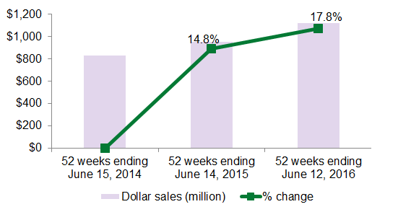
BFY snacks is a $1.1 billion market; room for growth exists
MULO sales of better-for-you snacks reached $1.1 billion in the 52 weeks ending June 12, 2016. This represents an 18% year-over-year increase and a 35% gain since 2014. Strong growth in the market comes from an increase in availability in this relatively young category at a time when consumer habits favor snacking and eating while on-the-go and a combined interest in healthy living and the pursuit of flavor. Mintel predicts the market will continue to see strong positive growth moving forward, largely driven by the opportunity to grow a consumer base.
BFY SNACKS IS A $1.1 BILLION MARKET; ROOM FOR GROWTH EXISTS
* sales through MULO, natural supermarket and specialty gourmet stores; does not include private label items or sales through Whole Foods Market
Source: SPINS/Mintel

Slide 4
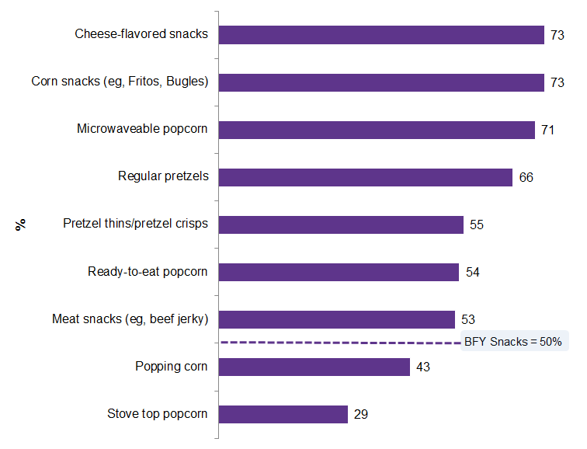
BFY snacks face competition from range of snack options
As snacking abounds, so too do sales and launches within the competitive set. The majority of common snack categories experienced strong dollar sales growth over the most recent five-year measurement period. Half of consumers purchase BFY snacks. This is lower than the penetration seen in other snack categories. Mintel finds higher consumer penetration in most non-BFY salty snacks segments. Snacks such yogurt, fruit, and vegetables, which may be seen to have a stronger health focus, also continue to grow.
SALTY SNACKS PURCHASE – ANY PURCHASE, JANUARY 2016
“Please tell us for whom in your household you have bought each of the following salty snacks for in the past six months. Please select ALL that apply per row.”
Base: 2,000 internet users aged 18+
Source: Lightspeed GMI/Mintel

Slide 5
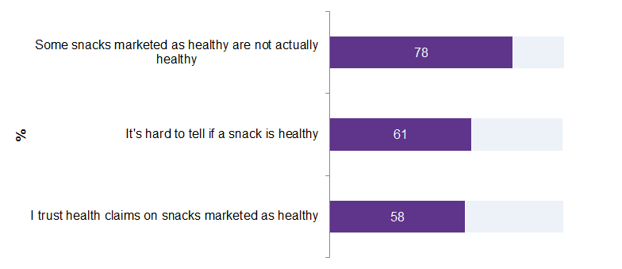
Consumers are skeptical of BFY snacks
78% of BFY snack buyers say some snacks that are marketed as healthy are actually not, and 61% say it’s hard to tell if a snack is healthy. Standing apart from the competition in the category will require transparency and winning the trust of consumers, especially as snack options abound across the board. Health appears to be a moving target, with 82% of respondents agreeing that the definition of what is healthy changes over time.
BFY SNACK ATTITUDES – AGREE, JUNE 2016
“Please indicate how much you agree or disagree with each of the following statements about snacks marketed as healthy. Please select one response per statement.”
Base: 993 internet users aged 18+ who've purchased BFY snacks in the past six months
Source: Lightspeed GMI/Mintel

Slide 6
The Opportunities
Vegetable and fruit chips experience the strongest dollar sales growth
Consumers ask for lower price points, more flavor from the category
Big can still be BFY

Slide 7
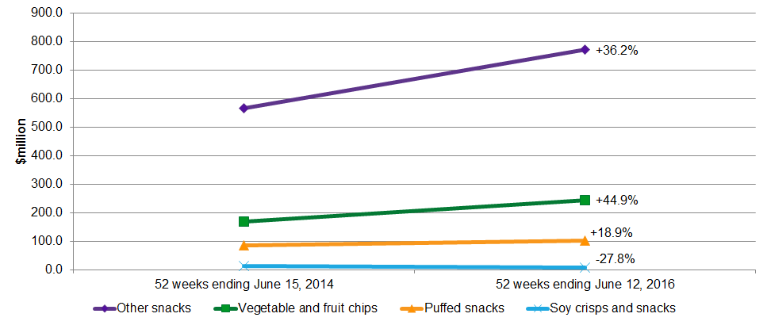
Vegetable and fruit chips experience the strongest dollar sales growth
The vegetable and fruit chips segment experienced the strongest dollar sales growth over the period. The importance of ingredient recognizability plays a role here, with fruit and vegetable chips being some of the most whole among category offerings. It also points to the willingness of consumers to go deeper into the BFY space, opting for veggie chips over some other chip types.
SALES* OF BFY SNACKS, BY SEGMENT, AT CURRENT PRICES, ROLLING 52 WEEKS ENDING JUNE 15, 2014 AND JUNE 12, 2016
* sales through MULO, natural supermarket and specialty gourmet stores; does not include private label items or sales through Whole Foods Market
Source: SPINS/Mintel

Slide 8
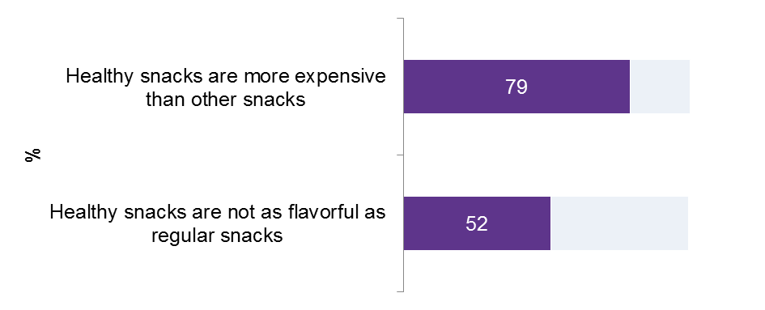
Consumers ask for lower price points, more flavor from the category
The majority of BFY snack buyers think products in the category are more expensive than other snacks. Communicating ways in which the products are worth the extra cost will be important to standing apart from the competition. Variety exists when referencing flavors reminiscent of a health snack. Unfortunately, “bland” appears with greater-than-average frequency. Innovation related to flavor can already be seen in the BFY snacks category.
BFY SNACK ATTITUDES – AGREE, JUNE 2016
“Please indicate how much you agree or disagree with each of the following statements about snacks marketed as healthy. Please select one response per statement.”
Base: 993 internet users aged 18+ who've purchased BFY snacks in the past six months
Source: Lightspeed GMI/Mintel

Slide 9
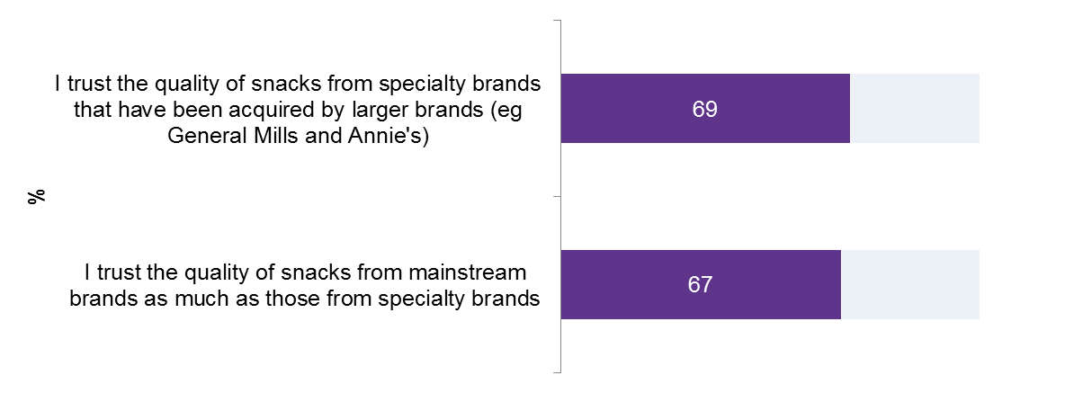
Big can still be BFY
67% of BFY snack buyers say they trust the quality of snacks produced by mainstream brands as much as that of specialty brands. What’s more, 69% say they trust the quality of specialty brands even after they’ve been acquired by larger entities. Quaker, Kashi, and Trader Joe’s rose to the top as brands (not necessarily category players) that are “getting it right” in terms of providing BFY options.
BFY SNACK ATTITUDES – AGREE, JUNE 2016
“Please indicate how much you agree or disagree with each of the following statements about snacks marketed as healthy. Please select one response per statement.”
Base: 993 internet users aged 18+ who've purchased BFY snacks in the past six months
Source: Lightspeed GMI/Mintel

Slide 10
What it Means
The nascent BFY snack market has room for growth, as snack-hungry consumers seek help with healthy eating. The category struggles with confusion over what represents health, and the perception of being too expensive and lacking flavor. As competition expands, along with the acceptance of what constitutes a snack, meeting consumer interest in good tasting and recognizable ingredients can boost participation.

Slide 11

Beth Bloom
Senior Analyst, Food and Drink
info@mintel.com
mintel.com

